Slide 1
Input
Lesson 1.7

Slide 2
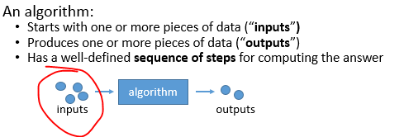
I need some input on this…

Slide 3


Events are happening all the time
onkeydown
onkeyup
onkeypress
onmousedown
onmousemove
onmouseup
onclick
ontouchstart
ontouchmove
ontouchend

Slide 4
Handling an event
function start() {
var canvas = document.getElementById("mainCanvas");
canvas.onmousemove = mouseMove;
}
function mouseMove(event) {
var x = event.clientX;
var y = event.clientY;
// do something here!
}

Slide 5



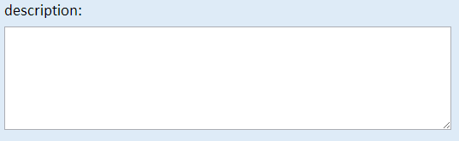

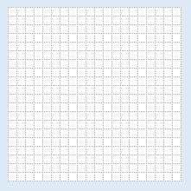





HTML input elements
onkeypress
onkeypress
onkeypress
onmousemove
onmousemove
onmousemove

Slide 6
1.7
1.7.1
Example (see the events happening)
1.7.2
Add events to an existing program
1.7.3
Experiment!
<!DOCTYPE html>
<html>
<head>
<title>Page Title</title>
<script src="events.js"></script>
<script src="messages.js"></script>
<link rel="stylesheet" href="events.css">
</head>
<body onload="start()">
…
</body>
</html>

